Slide 1
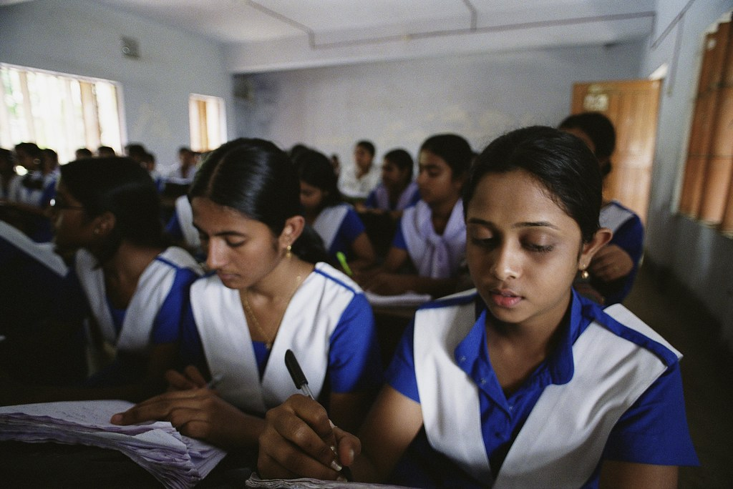
Students Performance and Behavior Analysis Using Power BI

Slide 2
Understanding student performance is crucial for improving educational outcomes. This study analyzes academic performance and behavioral factors to identify patterns that influence success.
Introduction

Slide 3
To examine the correlation between academic performance and behavioral factors. To identify key factors affecting students' grades. To provide insights for educators to enhance student success.
Objectives

Slide 4
Total Students: 5000 Attributes: Academic: Attendance, Exam Scores, Assignments, Quizzes, Participation, Total Score, Grade. Behavioral: Study Hours, Extracurricular Activities, Stress Levels, Sleep Hours. Demographics: Gender, Age, Department.
Dataset Overview

Slide 5
Attendance vs. Performance: Higher attendance correlates with better grades. Study Hours Impact: Students studying more than 15 hours per week tend to score higher. Extracurricular Activities: Participation in activities has mixed effects on performance. Stress & Sleep Patterns: High-stress students (score > 7) generally perform worse. Students sleeping <6 hours per night show lower academic scores. Performance: performance based on the department.
Key Findings

Slide 6
Visualizations (Power BI Dashboard)
Performance trends across different departments.
Scatter chart for academic and behavioral factors.
Distribution of grades based on attendance and study habits.
Use slicers for gender,department,stress level
Use card for average attendance by each department

Slide 7
Conclusion & Recommendations
Encourage Attendance: Attendance policies should be reinforced.
Promote Balanced Study & Rest: Students should maintain a structured study schedule and healthy sleep patterns.
Support Systems: Provide stress management programs and extracurricular balance.

Slide 8
Future Scope
Implement predictive models for student performance.
Conduct surveys to gain qualitative insights.
Expand analysis to include social and psychological factors.

Slide 9
Submitted By: TEAM 3
1. Data Collection & Preparation
PUNNYA NC: Gathered student performance data and cleaned the dataset.
DEEPU PRASAD H: Verified missing values and ensured data integrity.
2. Data Analysis & Insights
ADHIKESH RS: Conducted statistical analysis on academic performance.
SREERAG K: Examined behavioral factors like sleep and stress levels.
3. Power BI Dashboard & Visualization
DEEPU PRASAD H: Designed interactive dashboards for better insights.
ADHIKESH RS: Created correlation heatmaps and trend charts.
4. Report & Presentation
SREERAG K: Compiled key findings and structured the report.
PUNNYA NC: Designed the PowerPoint slides for the final presentation

Slide 10


